Slide 1
Deep Learning Project
Harold Gamarro
Joe Brian Malubay
Said Mejia
Juan Pablo Montoya

Slide 2
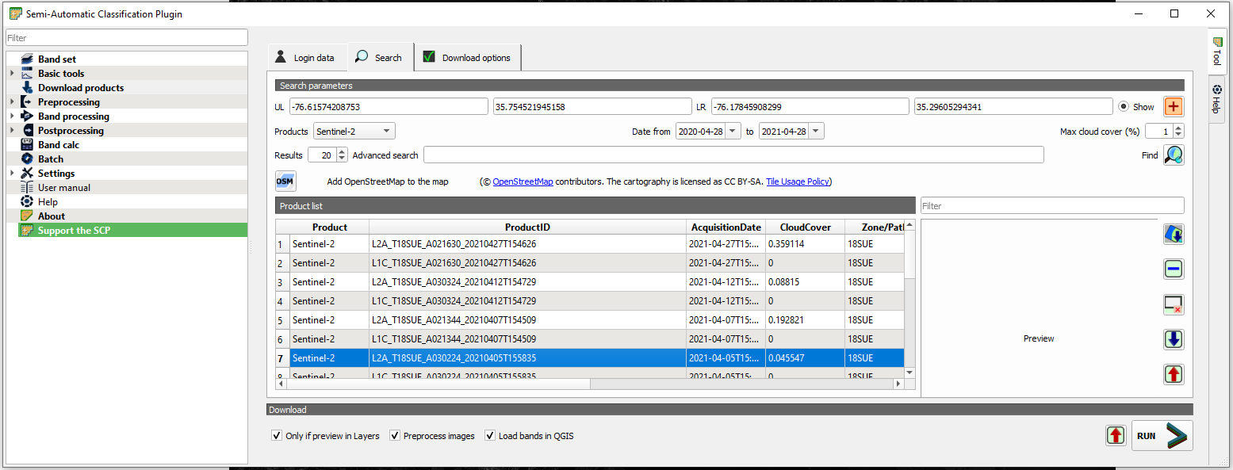

Slide 3
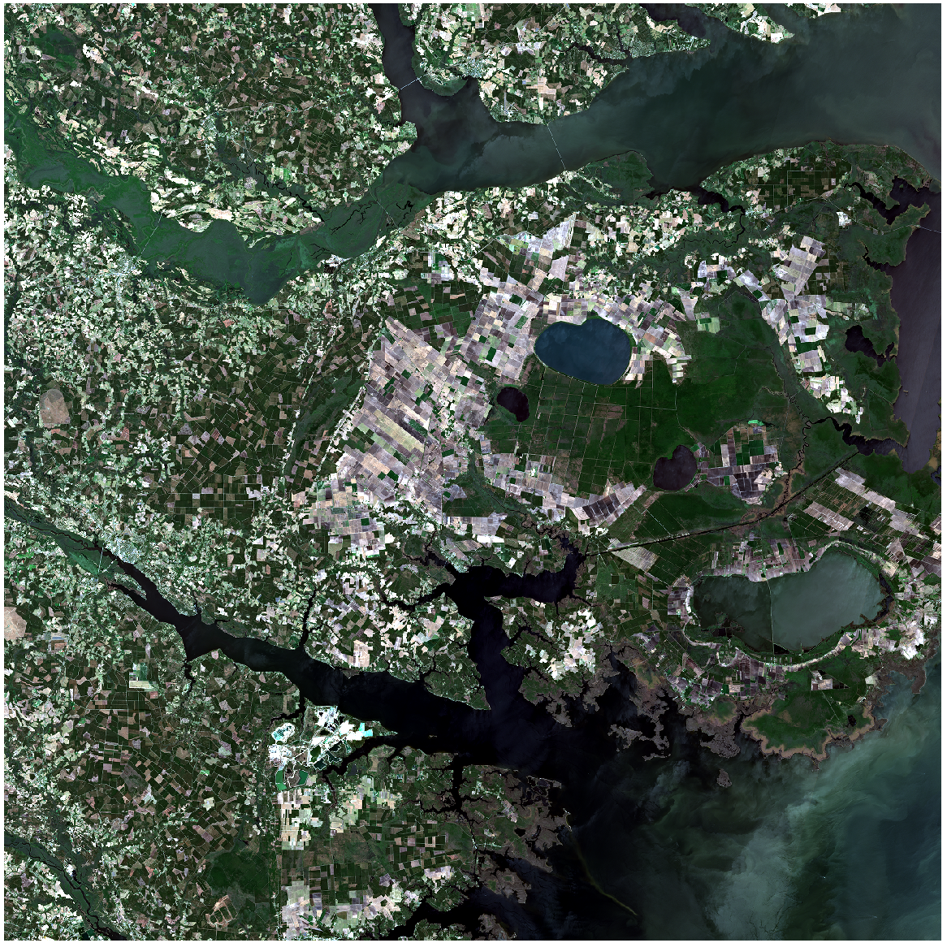
Processing Satellite image
Convert from jp2 with 13 bands to png with just 3 bands (RBG)

Slide 4
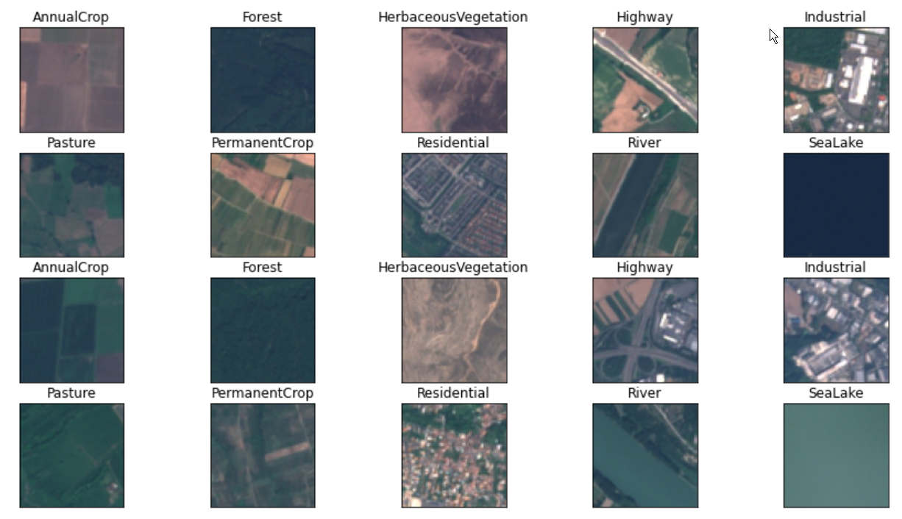
1st Dataset
Image (64x64x3)
Using ResNet

Slide 5
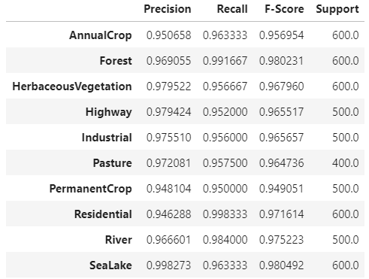
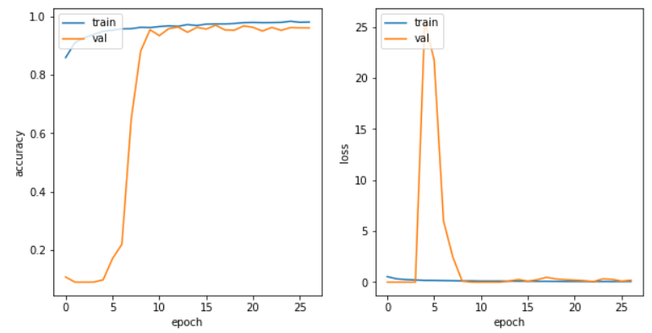
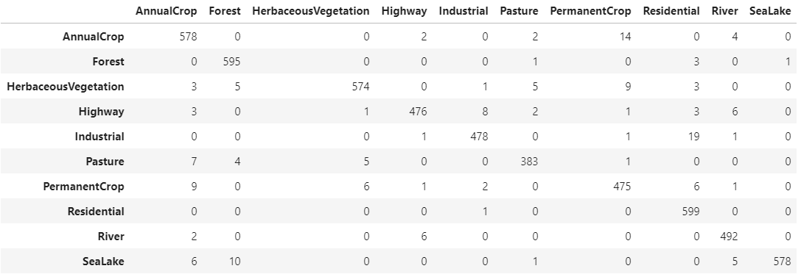

Slide 6
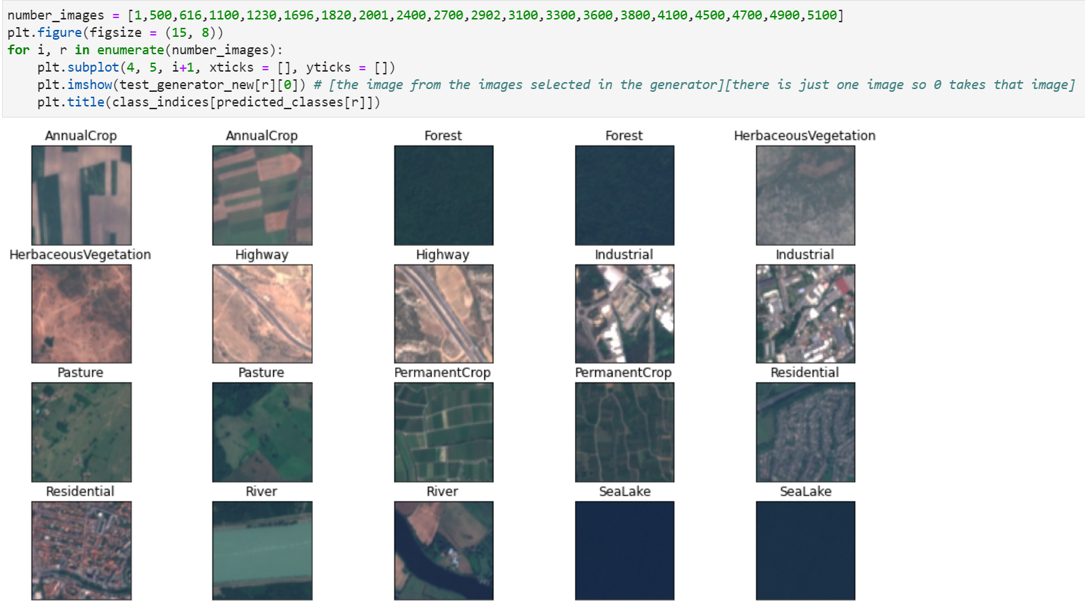
Results
Image (64x64x3)
Using ResNet

Slide 7
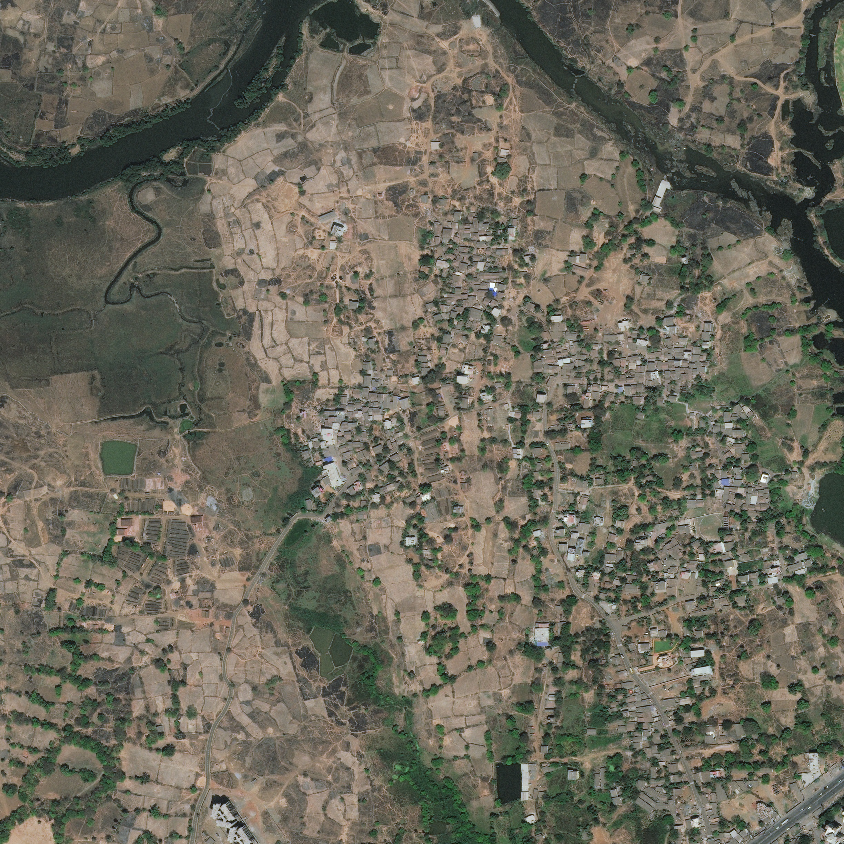
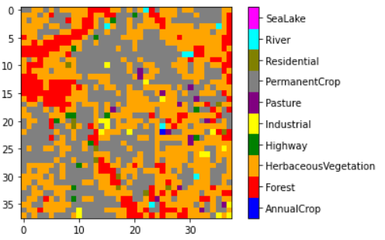
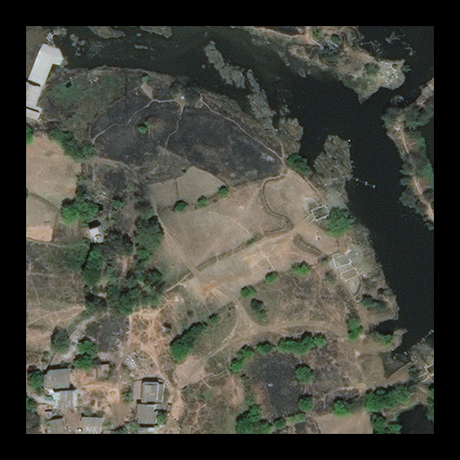
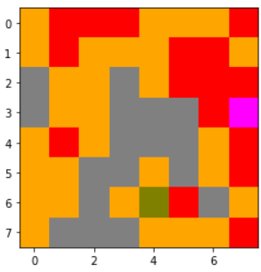
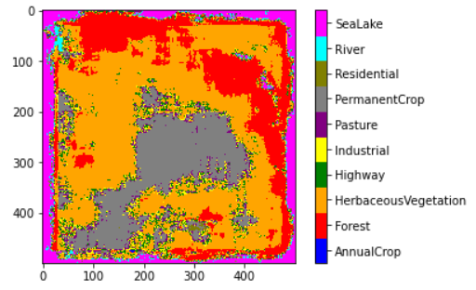
2448x2448x3
64x64
564x564x3
64x64
64x64 padded image

Slide 8
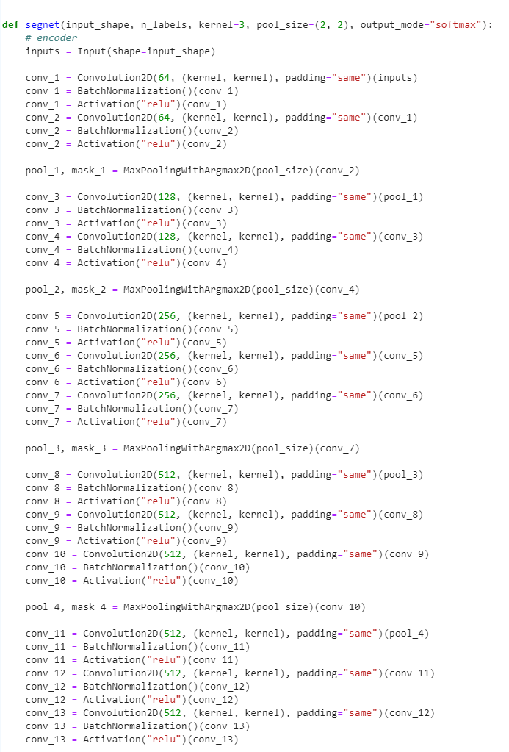
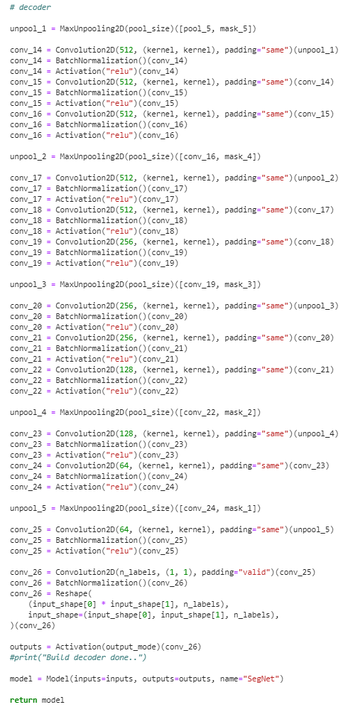
2nd Dataset
Image (64x64x3)
Using SegNet

